Slide 1



Development Individual Project Presentation
Design, Development and Demonstration
Presenter: Abdulrahman Husain Ahmed Alhashmi
This presentation covers the design, development, and demonstration of a Python-based intelligent agent for academic search and data management.

Slide 2



Project Aim and Problem Framing
Automate Retrieval
Structure Results
Support Repeatability
Automate retrieval from HTML inputs, with extensibility to live sources.
Structure results into a clean, tabular format with clear metadata.
Ensure repeatability through logging, testing, and clear documentation (README).
The agent addresses the repetitive nature of academic literature review: querying sources, parsing HTML, filtering noise, and collating data for analysis.

Slide 3








Conceptual Foundations: Agent-Oriented Principles
The design is influenced by core agent-oriented principles, modeling the agent with clear internal states and goals.
Beliefs
Desires
What data has been retrieved.
The target query and quality thresholds.
Structure
Intentions
Modular design with Controller, Scraper, Processor, and Storage Handler.
The plan for scraping, parsing, filtering, and storing data.
Autonomy is maintained at the workflow level: the agent decides which parser to invoke based on the page type.

Slide 4

Architecture Overview: The Five Modules
Agent Controller
Scraper
Data Processing
Storage Handler
Agent Controller: Coordinates the entire workflow.
Scraper: Handles HTTP/HTML tasks; can be extended with Selenium for dynamic pages.
Data Processing: Converts raw data to a pandas Data Frame and enforces schema.
Storage Handler: Persists outputs to CSV and Excel, verifying row counts.
Logger: Produces a trace for debugging and compliance.

Slide 5

Scraping and Parsing Strategy
Static Mode
Uses Requests and Beautiful Soup for predictable HTML pages. Used for the default demo for reproducibility.
Dynamic Mode (Optional)
Uses a WebDriver (e.g., Selenium) for sites requiring JavaScript rendering.
The parser extracts key metadata (title, authors, year, link) from article-like containers and returns a normalized record. It anticipates noisy input by handling missing fields with defaults and flagging invalid years.

Slide 6


Data Model and Validation
The Data Processing module enforces a minimal schema and applies three critical checks to ensure data quality.
Schema
Deduplication
Title (string), Authors (string), Year (integer or None), URL (string).
Removes duplicates based on matching Title and URL.
Validation
Normalization
Checks that years fall within a configurable range.
Trims whitespace and normalizes author delimiters.
The final output is a tidy Data Frame saved to CSV and Excel, simplifying downstream analysis like counting publications by year.

Slide 7
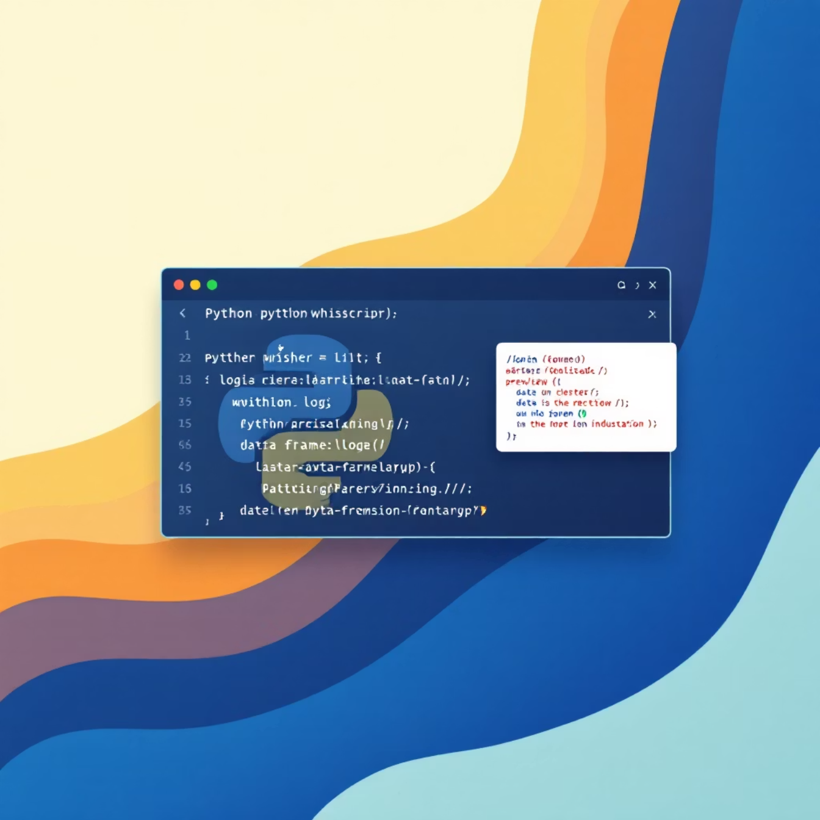
Demo Walkthrough: End-to-End Execution
1
Run Script
Execute demo.py.
2
Process Sample
Script reads sample_page.html and processes it through the pipeline.
3
Preview & Export
Prints a Data Frame preview and writes outputs to outputs/.
The demo highlight's function and traceability, showing log entries, record counts, and exported files without external connectivity. Screenshots of the successful run are included in the Evidence folder.

Slide 8

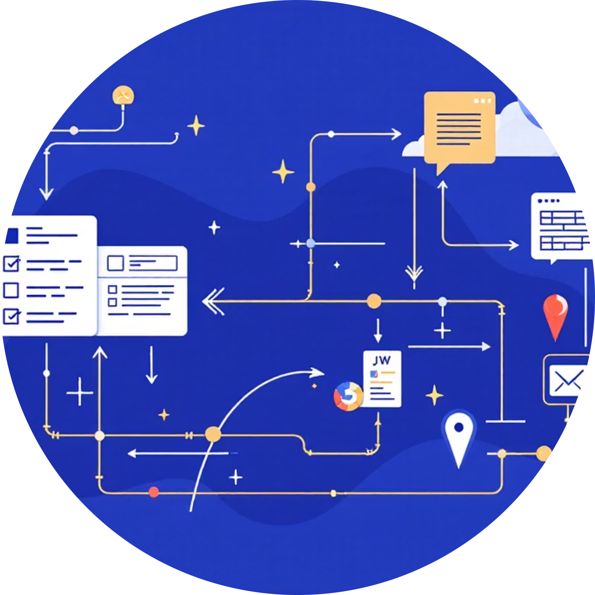
Testing Strategy and Traceability
Unit Tests
Functional Tests
Validate parsing functions against known HTML snippets, covering edge cases like missing authors or malformed years.
Run the full pipeline on the bundled sample and assert that output files exist and contain at least one row.

Slide 9
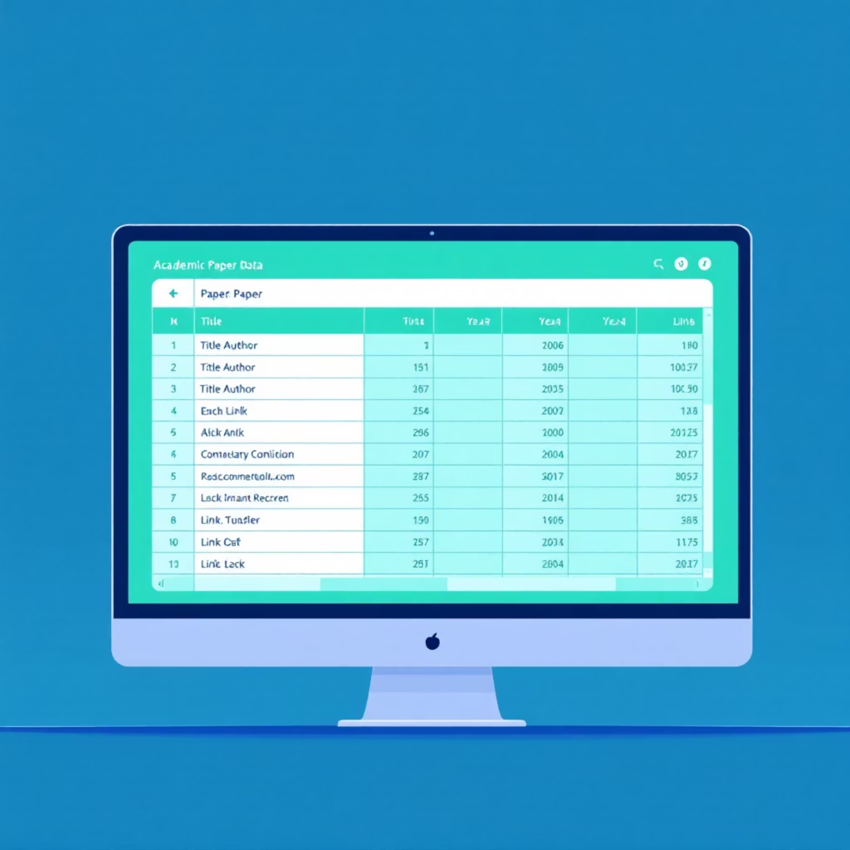
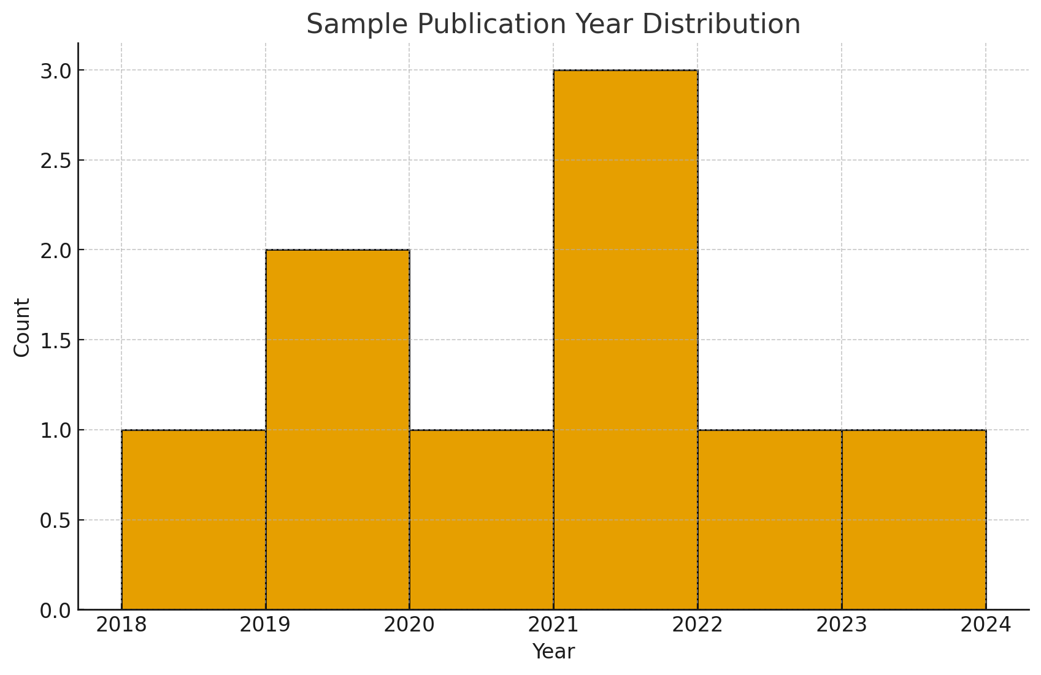
Results and Evidence
The pipeline successfully generated a structured table of papers, which was used to produce a simple year distribution chart.
Screenshots capture terminal output, test passes, and the exported files (CSV/Excel). These artifacts are mapped in the README for quick cross-checking by a marker.

Slide 10
Design Decisions and Future Work
Python Ecosystem
Modularity
Chosen for readability and rich data handling libraries (Pandas).
Clear responsibilities support future extensions (e.g., semantic filters).
Static vs. Dynamic
Future: Agent Framework
Beautiful Soup for speed; Selenium isolated for optional dynamic content (a trade-off).
Can integrate a full BDI framework (like SPADE) for belief updates and failure handling.
Limitations include reliance on bundled HTML for portability: real world pages require specialized parsers. Future work includes semantic ranking, duplicate detection, and active learning to refine filters.

Slide 11
References:
Bellifemine, F., Caire, G. and Greenwood, D. (2007) Developing multi-agent systems with JADE. Chichester: John Wiley & Sons.
Booch, G., Rumbaugh, J. and Jacobson, I. (2005) The Unified Modelling Language user guide. 2nd edn. Boston: Addison-Wesley.
Lutz, M. (2013) Learning Python. 5th edn. Sebastopol: O’Reilly Media.
McKinney, W. (2012) Python for data analysis: Data wrangling with pandas, NumPy, and IPython. Sebastopol: O’Reilly Media.
Mitchell, R. (2018) Web scraping with Python: Collecting data from the modern web. 2nd edn. Sebastopol: O’Reilly Media.
Pressman, R. and Maxim, B. (2020) Software engineering: A practitioner’s approach. 9th edn. New York: McGraw-Hill.
Van Rossum, G. and Drake, F. (2009) Python 3 reference manual. Scotts Valley: CreateSpace.
Wooldridge, M. (2009) An introduction to multi-agent systems. 2nd edn. Chichester: John Wiley & Sons.
University of Essex Online (2025) Intelligent Agents Development: Individual Project Presentation, Unit 11 assignment brief. Module resource.

